Slide 15
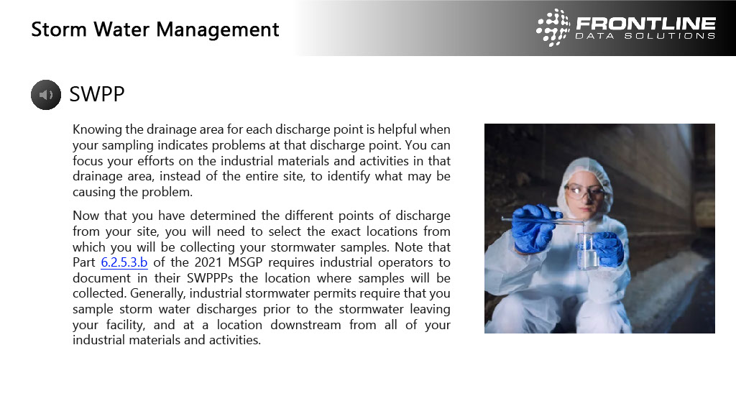

Slide 18
7.59"

